Slide 1
ITMD 536 Software Testing & Maintenance
Chapter 4 Test Design Techniques

Slide 2
Objectives
What is Test Design Technique?
What is the test case, and test procedure?
What is test condition, test case and test procedure?
What is traceability and expected results?
What black-box and white-box testing?

Slide 3
4.1. Test Design Techniques
By design we mean to create a plan for how to implement an idea and technique is a method or way for performing a task. So, Test Design is creating a set of inputs for given software that will provide a set of expected outputs.
Procedure used to derive and/or select test cases.

Slide 4
4.1 The Test Development Process
Before a test is executed we need to know what is our end goal what are we trying to test, the inputs, the results that should be produced by those inputs and how we can get ready to run the test.
Review test conditions, test cases, and test procedures (or scripts) follow the Test Documentation Standards (IEEE 829)

Slide 5
4.1 The Test Development Process
Test cases are document in the test case specification.
Test case specification: A document specifying a set of test cases (objective, inputs, test actions, expected results, and execution preconditions) for a test item.

Slide 6
4.1 The Test Development Process
Test procedures are documented in a Test Procedure Specification (also known as a test script or a manual test script).

Slide 7
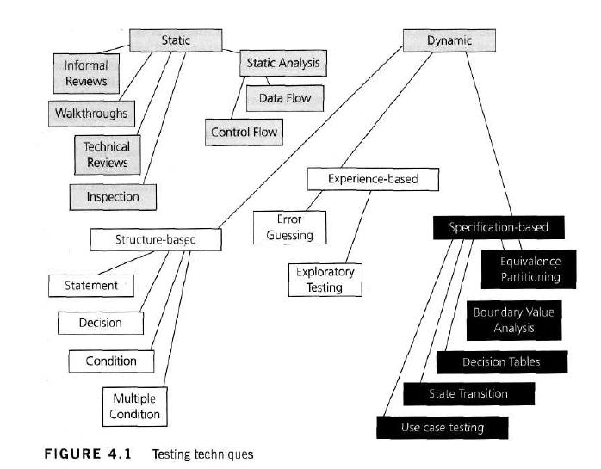

Slide 8
4.1.1 Formality of test documentation
Formal testing would have extensive documentation and well controlled. It would include the detail of exact and specific input and expected outcome of the test.
The thoroughness of test documentation also depends on time constraints.

Slide 9
4.1.2 Test analysis: identifying test conditions
Test analysis is the process of looking at something that can be used to derive test information.
This basis of the tests is called the “test basis”. This could be a system requirement, a technical requirement or the code itself (for structural testing) or a business process.

Slide 10
4.1.2 Test analysis: identifying test conditions
Test basis provides us the information as to what could be tested – these are the test conditions.
A test condition is simply something that we could test.
List of test conditions are the decision outcomes (True and False).

Slide 11
4.1.2 Test analysis: identifying test conditions
Testing technique helps us select a good set of test from the total number of all possible tests for a given system.
Tests might based on risk, models of the system, likely failures, compliance requirements, expert advice or heuristics (I find).

Slide 12
4.1.2 Test analysis: identifying test conditions
Test conditions should be linked back to their sources in the test basis and it’s called traceability.
Traceability: The ability to identify related items in documentation and software, such as requirements with associated tests.

Slide 13
4.1.2 Test analysis: identifying test conditions
Traceability is important because:
Verify function or feature changes
How many tests will be affected with any change in requirement.
Before new release we need to have the tests results with specified requirements that are tested and passed.

Slide 14
4.1.2 Test analysis: identifying test conditions
Horizontal traceability: The tracing of requirements for a test level through the layers of test documentation (e.g. test plan, test design specification, test case specification and test procedure specification or test script).

Slide 15
4.1.2 Test analysis: identifying test conditions
Vertical traceability: The tracing of requirements through the layers of development documentation to components.
Test conditions are documented in the IEEE 829 called a Test Design Specification.

Slide 16
IEEE 829 Standard: Test Design Specification Template
Test design specification identifier
Features to be tested
Approach refinements
Test identification
Feature pass/fail criteria

Slide 17
4.1.3 Test design: specifying test cases
A test case needs to have input values, of course, but just having some values to input to the system is not a test!
You need to know what the system is supposed to do with the inputs, you can’t tell whether your test has passed or failed

Slide 18
4.1.3 Test design: specifying test cases
The test case also specifies the environment and other things that must be in place before the test can be run (the preconditions) and any things that should apply after the test completes (the post conditions).

Slide 19
IEEE 829 Standard: Test Case Specification Template
Test case specification identifier
Test items
Input specifications
Output specifications
Environmental needs
Special procedural requirements
Interface dependencies

Slide 20
4.1.4 Test implementation: specifying test procedures or scripts
Test cases need to be grouped and executed in sequential order to get the valuable results.
The document that describes the steps to be taken in running a set of tests is called a test procedure in IEEE 829 and is also referred to as a test script.

Slide 21
4.1.4 Test implementation: specifying test procedures or scripts
Test script Commonly used to refer to a test procedure specification, especially an automated one.

Slide 22
4.1.4 Test implementation: specifying test procedures or scripts
Test Execution schedule A scheme for the execution of test procedures. The test procedures are included in the test execution schedule in their context and in the order in which they are to be executed.

Slide 23
4.1.4 Test implementation: specifying test procedures or scripts
A regression script may always be the first to be run when a new release of the software arrives, as a smoke test or sanity check.

Slide 24
4.1.4 Test implementation: specifying test procedures or scripts
Writing the test procedure is another opportunity to prioritize the tests, to ensure that the best testing is done in the time available. A good rule of thumb is ‘Find the scary stuff first’.

Slide 25
IEEE 829 Standard: Test Procedure Specification Template
Test procedure specification identifier
Purpose
Special requirements
Procedure steps

Slide 26
4.2.1 Introduction
There are two main categories of testing:
Static and
Dynamic

Slide 27
4.2.1 Introduction
Dynamic techniques are divided into three categories:
Specification-based (black-box/behavioral techniques),
Structure-based (white-box or structural techniques),
Experienced-based

Slide 28
4.2.2 Static testing techniques
Static testing techniques do not execute the code being examined and are generally used before any tests are executed on the software.
They could be called non-execution techniques.
Tests the source code.

Slide 29
4.2.3 Specification-based (black-box) testing techniques
Dynamic testing will look at the specification-based testing also know as black-box testing or input/output driven testing.
Black-box testing either functional or non-functional, without reference to the internal structure of the component or system.

Slide 30
4.2.4 Structure-based (white-box) testing techniques
Structure-based testing is also known as ‘white-box’ or ‘glass-box’ testing.
White-box testing is based on an analysis of the internal structure of the component or system.

Slide 31
4.2.5 Experience-based testing techniques
Experienced-based test design technique
Procedure to derive and /or select test cases based on the tester’s experience, knowledge and intuition.

Slide 32
4.2.5 Experience-based testing techniques
In experience-based techniques people’s knowledge, skills and background are a prime contributor to the test conditions and test cases.
The experience of both technical and business people is important, as they bring different perspective to the test analysis and design process.

Slide 33
4.2.6 Where to apply the different categories of techniques
Specification-based techniques are appropriate at all levels of testing (component testing through to acceptance testing) where a specification exists.
Structure-based techniques can also be used at all levels of testing.

Slide 34
4.2.6 Where to apply the different categories of techniques
Experienced-based techniques are used to complement specification-based and structure-based techniques, and are also used when there is no specification, or the specification is inadequate or out of date.

Slide 35
4.3 Specification-Based or Black-Box Techniques
Black-box test design technique: Produces to derive and/or select test cases based on an analysis of the specification, either functional or non-functional, of a component or system without reference to its internal structure.

Slide 36
4.3 Specification-Based or Black-Box Techniques
There are four specification-based techniques:
Equivalence partitioning;
Boundary value analysis;
Decision tables;
State transition testing.

Slide 37
4.3.1 Equivalence partitioning and boundary value analysis
Equivalence partitioning: A black box test design technique in which test cases are designed to execute representatives from equivalence partitions. In principle test cases are designed to cover each partition at least once.

Slide 38
4.3.1 Equivalence partitioning and boundary value analysis
Equivalence partition A portion of an input or output domain for which the behavior of a component or system is assumed to be the same, based on the specification.

Slide 39
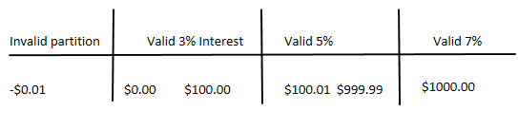
4.3.1 Equivalence partitioning and boundary value analysis
Bank account with $0-100 has 3% interest and so on.. see example

Slide 40
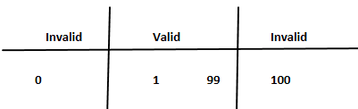
Boundary Value Analysis
Boundary Value Analysis(BVA): A black box test design technique in which test cases are designed based on boundary values.

Slide 41
Boundary Value
Boundary Value: An input value or output value which is on the edge of an equivalence partition or at the smallest incremental distance on either side of an edge, for example the minimum or maximum value of a range.

Slide 42
Extending equivalence partitioning and boundary value analysis
Equivalence partitions and boundaries
Digits (0-9) invalid partition containing non-digits
Number of digits, 3 invalid values 2 and 4 digits
Range of extension 100 to 699 invalid values 099 - 700

Slide 43
Designing Test Cases
A set of input values, execution preconditions, expected results and execution postconditions, developed for a particular objective or test condition, such as to exercise a particular program path or to verify compliance with a specific requirement.

Slide 44
Why do both equivalence partitioning and boundary value analysis?
Technical, because every boundary is in some partition, if you did only boundary value analysis you would also have tested every equivalence partition.

Slide 45
4.3.2 Decision Table Testing
Decision Table Testing: A black box test design technique in which test cases are designed to execute the combinations of inputs and/or stimuli (cases) shown in a decision table.
Decision Table Testing and Transition Testing are more focused on business logic and business rules.

Slide 46
4.3.2 Decision Table Testing
Decision Table: A table showing combinations of inputs and/or stimuli (causes) with their associated outputs and/or actions (effects),which can be used to design test cases.
A decision table is a good way to deal with combinations of things (inputs). This technique is also called cause-effect’ table.

Slide 47
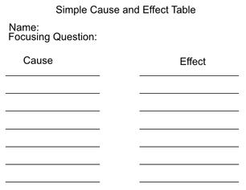
Using Decision Tables for Test Design

Slide 48
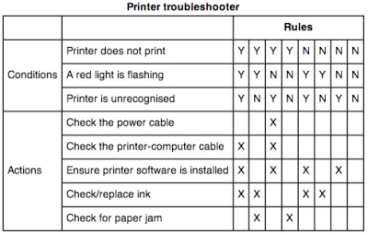
Using Decision Tables for Test Design

Slide 49
4.3.3 State Transition Testing
State Transition Testing: A black box test design technique in which test cases are designed to execute valid and invalid state transitions.
State transition testing is used where some aspects of the system can be described in what is called a ‘finite state machine’.

Slide 50
4.3.3 State Transition Testing
State Diagram: A diagram that depicts the states that a component or system can assume, and shows the events or circumstances that cause and/or result from a change from one state to another.
A finite state system is often shown as a state diagram.

Slide 51
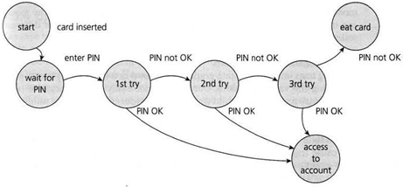
State Diagram for PIN Entry – withdraw $100 at ATM

Slide 52
State Transition Model has Four Parts
States software may occupy (open/closed or funded/insufficient funds);
Transaction form one State to another State (not all transactions are allowed);

Slide 53
State Transition Model has Four Parts
Events that cause a transaction (closing a file or withdrawing money);
Actions that result from a transition (an error message or being given your cash).

Slide 54
Testing for Invalid Transactions
State Table: A grid showing the resulting transitions for each state combined with each possible event, showing both valid and invalid transitions.

Slide 55
State Table for the PIN

Slide 56
4.3.4 Use Case Testing
Use Case Testing: A black box test design technique in which test cases are designed to execute scenarios of use cases.
Use case testing is a technique that helps us identify test cases that exercise the whole system on a transaction by transaction basis from start to finish.

Slide 57
4.3.4 Use Case Testing
Use cases are a sequence of steps that describe the interactions between the actor and the system.
Use cases can uncover integration defects.
Use cases describe the process flows through a system based on its most likely use.

Slide 58
Partial Use Case for PIN Entry

Slide 59
Structure-Based or White-Box Techniques
White-box test design technique: Procedure to derive and/or select test cases based on an analysis of the internal structure of a component or system.

Slide 60
White-box technique
White-box technique focus on the structure of a software component, such as statements, decisions, branches or even distinct paths.

Slide 61
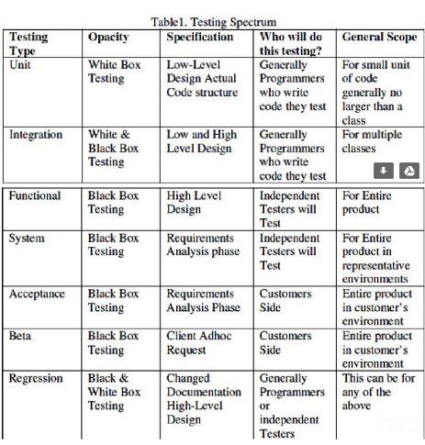

Slide 62
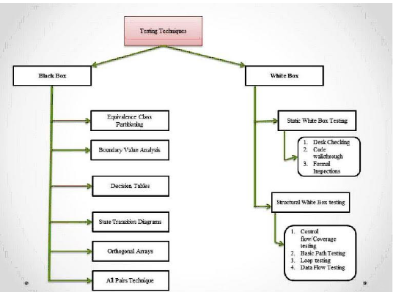

Slide 63
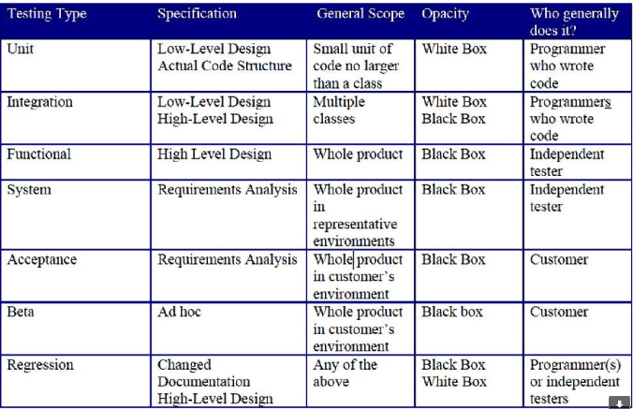
Black-Box Testing Levels

Slide 64
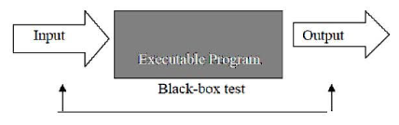
Black-Box Test

Slide 65
Pair-wise Combination of Parameters- Sample array

Slide 66
Orthogonal Arrays
Orthogonal Array Testing Strategy (OATS) is a systematical, statistical way of testing pair-wise interactions by deriving suitable small set of test cases from a large number of scenarios.

Slide 67
Orthogonal Arrays
The testing strategy can be used to reduce the number of test combinations and provide maximum coverage with a minimum number of test cases. OATS utilizes an array of values representing variable factors that are combined pair-wise rather than representing all combinations of factors and levels.

Slide 68
4.4 Structure-Based or White-Box Techniques
White-box test design technique: Procedure to derive and/or select test cases based on an analysis of the internal structure of a component.
White-box testing: Testing is based on an analysis is of the internal structure of the component or system.

Slide 69
White-Box Testing Techniques
White box testing techniques are:
1. Static white box testing a. Desk checking b. Code walkthrough c. Formal Inspections
2. Structural White box testing a. Control flow/ Coverage testing b. Basic path testing c. Loop testing d. Data flow testing

Slide 70
4.4.1 Using structure-based techniques to measure coverage and design tests
Coverage (test coverage) The degree, expressed as a percentage, to which a specified coverage item has been exercised by a test suite.

Slide 71
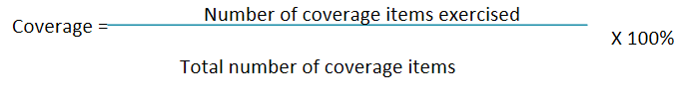
What is a test coverage?
Test coverage measures in specific way the amount of testing performed by the set of tests. The basic coverage measure is:

Slide 72
Types of coverage
Coverage can be measured at component-testing level, integration-testing level, or at a system- or acceptance testing levels.
Component is at the code level
Integration covers interfaces
System or user covers requirements

Slide 73
Types of coverage
Specification-based techniques:
EP: percentage of equivalence partitions exercised. (valid & invalid)
BVA: percentage of boundaries. (V&I)
Decision tables: business rules or decision table.

Slide 74
Types of coverage
State transition testing:
Percentage of states visited
Percentage of (valid) transitions exercised (Chow’s 0-witch coverage)
Percentage of pairs of valid transitions and longer series of transitions
Percentage of invalid transitions exercised

Slide 75
How to measure coverage
Coverage measurement tool alters the code by inserting instrumentation:
Decide on the structural element to used (coverage items need to counted).
2. Count the structural elements or items.

Slide 76
How to measure coverage
3. Instrument the code.
4. Run the tests for which coverage measurement is required.
5. Using the output from the instrumentation, determine the percentage of elements of or items exercised.

Slide 77
How to measure coverage
Structure based test case design:
If you are targeting to cover 95% and you only have 87% then you need to add the additional test cases.

Slide 78
4.4.2 Statement coverage and statement testing
Statement coverage: The percentage of executable statements that have been exercised by a test suite.

Slide 79
4.4.3 Decision coverage and decision testing
Decision coverage: The percentage of decision outcomes that have been exercised by a test suite. 100% decision coverage implies both 100% branch coverage and 100% statement coverage.

Slide 80
4.4.4 Other structure-based techniques
Branch coverage: The percentage of branches that have been exercised by the test suite. 100% branch coverage implies both 100% decision coverage and 100% statement coverage.

Slide 81
4.5 Experience Based Techniques
There is a definite role for non-systematic techniques, i.e. tests based on a person’s knowledge, experience, imagination and intuition. The reason is that some defects are hard to find using more systematic approaches.

Slide 82
4.5.1 Error guessing and fault attacks
Error guessing is a technique that should be always used as complement to other formal techniques.
Fault attack: Directed and focused attempt to evaluate the quality, especially reliability, of a test object by attempting of force specific failures to occur.

Slide 83
4.5.2 Exploratory testing
Exploratory testing: An informal test design technique where the tester actively controls the design of the test as those test are performed and uses information gained while testing to design new and better tests.

Slide 84
4.6 Choosing Test Techniques
The choice of which test techniques to use depends on a number of factors, including the type of system, regulatory standards, customer or contractual requirements, level of risk, type of risk, test objective, documentation available, knowledge of the tester, time and budget, development life cycle, use case models and pervious experience to find different defects.

Slide 85
Decision which technique to be used
Model used: If specification contains a state transition diagram, - use state transition testing.
Tester knowledge/experience: Tester knowledge is very useful and use it.
Likely defects: This knowledge is gained through experience.

Slide 86
Decision which technique to be used
Test objective: This should be through testing and use structure-based technique.
Documentation: Documentation influences the testing technique e.g. decision tables, state graphs etc.
Life cycle model: Sequential life cycle leads to more formal technique.

Slide 87
External factors that influence which technique should be used
Risk: Exploratory testing is appropriate.
Customer/contractual requirements: Sometimes you need to use contract specific technique for testing.

Slide 88
External factors that influence which technique should be used
Type of system: Specially for financial sector, insurance or healthcare industry you need lots of calculations and would be necessary to have boundary value analysis.

Slide 89
External factors that influence which technique should be used
Regulatory requirements: For example FAA airline industry, FDA food and drug administration, healthcare HIPAA law.

Slide 90
External factors that influence which technique should be used
HIPAA is the acronym for the Health Insurance Portability and Accountability Act that was passed by Congress in 1996. HIPAA does the following: Provides the ability to transfer and continue health insurance coverage for millions of American workers and their families when they change or lose their jobs

Slide 91
External factors that influence which technique should be used
Time and budget: Ultimately how much time and money is available for testing. Depending on the time and budget you can select which type of testing can be used.

Slide 92
4. Test Design Techniques-Question 1
1. In which document described in IEEE 829 would you find instructions for the steps to be taken for a test including set-up, logging, environment and measurement?
a. Test plan
b. Test design specification
c. Test case specification
d. Test procedure specification

Slide 93
4. Test Design Techniques - Question 2
2. With a highly experienced tester with a good business background, which approach to defining test procedures would be effective and most efficient for a project under server time pressure?

Slide 94
4. Test Design Techniques-Question 2
a. A high-level outline of the test conditions and general steps to take.
b. Every step in the test spelled out in detail.
c. A high-level outline of the test conditions with the steps to take discussed in detail with another experienced tester.
d. Detailed documentation of all test cases and careful records of each step taken in the testing.

Slide 95
4. Test Design Techniques-Question 3
3. Put the test cases that implement the following test conditions into the best order for the test execution schedule, for a test that is checking modifications of customers on a database.
1. Print modification customer record.
2. Change customer address: house number and street name.

Slide 96
4. Test Design Techniques-Question 3
3. Capture and print the on-screen error message.
4. Change customer address: postal code.
5. Confirm existing customer is on the database by opening that record.
6. Close the customer record and close the database.
7. Try to add a new customer with no details at all.

Slide 97
4. Test Design Techniques-Question 3
a. 5,4,2,1,3,7,6
b. 4,2,5,1,6,7,3
c. 5,4,2,1,7,3,6
d. 5,1,2,3,4,7,6

Slide 98
4. Test Design Techniques-Question 4
4. Why are both specification-based and structure-based testing techniques useful?
a. They find different types of defect.
b. Using more techniques is always better.
c. Both find the same types of defect.
d. Because specifications tend to be unstructured.

Slide 99
4. Test Design Techniques-Question 5
5. What is a key characteristic of structure-based testing techniques?
a. They are mainly used to assess the structure of a specification.
b. They are used both to measure coverage and to design tests to increase coverage.
c. They are based on the skills and experience of the tester.
d. They use a formal or informal model of the software or component.

Slide 100
4. Test Design Techniques-Question 6
6. Which of the following would be an example of decision-table testing for a financial application applied a the system-test level?
A table containing rules for combination of inputs to two fields on a screen.
b. A table containing rules for interfaces between components.
c. A table containing rules for mortgage applications.
d. A table containing rules for chess.

Slide 101
4. Test Design Techniques-Question 7
7. Which of the following could be a coverage measure for the state transition testing?
V All states have been reached.
W The response time for each transaction is adequate.
X Every transition has been exercised.
Y All boundaries have been exercised.
Z Specific sequences of transitions have been exercised.

Slide 102
4. Test Design Techniques-Question 7
a. X,Y and Z
b. V,X,Y and Z
c. W, X and Y
d. V, X and Z

Slide 103
4. Test Design Techniques-Question 8
8. Postal rates for ‘light letters’ are 25p up to 10g, 35p up to 50g plus an extra 10p for each additional 25g up to 100g.
Which test inputs (in grams) would be selected using equivalence partitioning?
a. 8, 42, 82, 102
b. 4, 15, 65, 92, 159
c. 10, 50, 75, 100
d. 5, 20, 40, 60, 80

Slide 104
4. Test Design Techniques-Question 9
9. Which of the following could be used to access the coverage achieved for specification-based (black-box) test techniques?
V Decision outcomes exercised
W Partitions exercised
X Boundaries exercised
Y State transitions exercised
Z Statements exercised

Slide 105
4. Test Design Techniques-Question 9
a. V, W, Y or Z
b. W, X or Y
c. V, X or Z
d. W, X, Y or Z

Slide 106
4. Test Design Techniques-Question 10
10. Which of the following would structure-based test design techniques be most likely to be applied to?
1. Boundaries between mortgage interest rate bands.
2. An invalid transition between two different arrears statuses.
3. The business process flow for mortgage approval.
4. Control flow of the program to calculate repayments.

Slide 107
4. Test Design Techniques-Question 10
a. 2, 3 and 4
b. 2 and 4
c. 3 and 4
d. 1, 2 and 3

Slide 108
4. Test Design Techniques-Question 11
11. Use case testing is useful for which of the following?
P Designing acceptance tests with users or customers.
Q Making sure that the mainstream business processes are tested.
R Finding defects in the interaction between components.
S Identifying the maximum and minimum values for every input filed
T Identifying the percentage of statements exercised by a sets of tests.

Slide 109
. Test Design Techniques-Question 11
a. P, Q and R
b. Q, S and T
c. P, Q and S
d. R, S and T

Slide 110
4. Test Design Techniques-Question 12
12. Which of the following statements about the relationship between statement coverage and decision is correct?

Slide 111
4. Test Design Techniques-Question 12
a. 100% decision coverage is achieved if statement coverage is greater than 90%
b. 100% statement coverage is achieved if statement coverage is greater than 90%.
c. 100% decision coverage always means 100% statement coverage.
d. 100% statement coverage always means 100% decision coverage.

Slide 112
4. Test Design Techniques-Question 13
13. If you are flying with a an economy ticket, there is a possibility that you may get upgraded to business class, especially if you hold a gold card in the airline’s frequent flier program. If you don’t hold a gold card, there is a possibility that you will get ‘bumped’ off the flight if it is a full and you check in late.

Slide 113
4. Test Design Techniques-Question 13
Check control flow diagram(flight check-in)
Three test have been run:
Test 1: Gold card holder who gets upgraded to business class.
Test 2: Non-gold card holder who stays in economy.
Test 3: A person who is bumped form the flight. What is the statement coverage of these three tests?

Slide 114
4. Test Design Techniques-Question 13
a. 60%
b. 70%
c. 80%
d. 90%

Slide 115
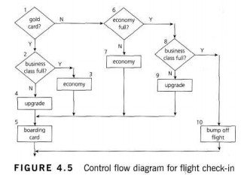
4.Test Design Techniques-Question 14

Slide 116
4.Test Design Techniques-Question 14
14 Why are error guessing and exploratory testing good to do?
a. They can find defects missed by specification-based and structure-based techniques.
b. They don’t require any training to be as effective as formal techniques.
c. They can be used most effectively when there are good specifications.
d. They will ensure that all of the code or system is tested.

Slide 117
4.Test Design Techniques-Question 15
15. How do experience-based techniques differ from specification-based techniques?
a. They depend on the tester’s understanding of the way the system is structured rather than on a documented record of what the system should do.
b. They depend on having older testers rather than younger testers.
c. They depend on a documented record of what the system should do rather than on an individual’s personal view.
d. They depend on an individual’s personal view rather than on a documented record of what the system should do.

Slide 118
4.Test Design Techniques-Question 16
16 When choosing which technique to use in a given situation, which factor should be taken into account?
U Previous experience of types of defects found in this or similar systems.
V The existing knowledge of the testers.
W Regulatory standards that apply.
X The type of test execution tool that will be used.
Y The documentation available.
Z Pervious experience in the development language

Slide 119
4.Test Design Techniques-Question 16
a. V, W, Y and Z
b. U, V, W and Y
c. U, X and Y
d. V, W and Y

Slide 120
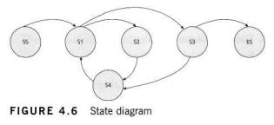
4.Test Design Techniques-Question 17
17. Given the state diagram in Figure 4.6,which test case is the minimum series of valid transitions to cover every state?

Slide 121
4.Test Design Techniques-Question 17
SS – S1 – S2 – S4 – S1 – S3 – ES
SS – S1 – S2 – S3 – S4 – ES
SS – S1 – S2 – S4 – S1 – S3 – S4 – S1 – S3 – ES
SS – S1 – S4 – S2 – S1 – S3 – ES

